Slide 1

Programming One (csc7050)
Aidan McGowan
Importing a class
Use of Scanner class

Slide 2

Importing
An import statement is a way of making more of the functionality of Java available to your program. The Java API has a very rich function set but not every program needs to access to all functionality. So, to cut things down to size Java has its classes divided into packages which you can optionally import.

Slide 3
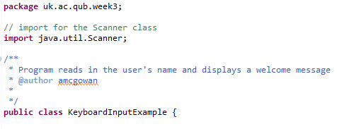
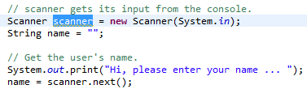
Importing a Package Member
To import a specific member into the current file, put an import statement at the beginning of the file before any type definitions but after the package statement.
Now you can refer to the Scanner class by its simple name from within the code.

Slide 4



Importing – classes
Importing a Package Member
  import java.util.Scanner;
Importing an Entire Package
  import java.util.*;
Referring to a Package Member by the class Qualified Name
  java.util.Scanner scanner = new java.util.Scanner(System.in);
Loads ALL the classes in the package
Note : no efficiently difference between import package member but does take longer to type !

Slide 5
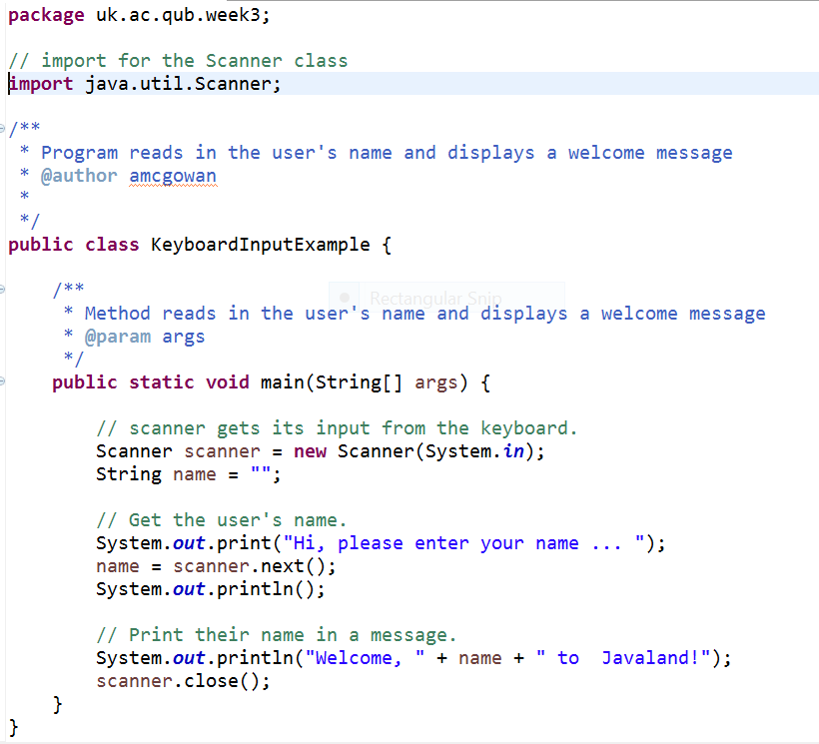
Example program using Scanner class for user interaction

Slide 6
Exercise I
Create a Java program that asks the user to input his / her age
Depending on the input the output should then be
Input (Age) | Output
>= 18 | You can vote
< 18 | You cannot vote
Hints : Store the user’s age as an int
The Scanner class has a specific method for getting the next int.
if (age >=18) {
…..
}
Notes:
Solution …
package uk.ac.qub.week3;
import java.util.Scanner;
public class ScannerAgeExercise {
public static void main(String[] args) {
// vars
int userAge;
userAge = 0;
// set up scanner
Scanner scanner = new Scanner(System.in);
// get the input from the user
System.out.println("What age are you ?");
userAge = scanner.nextInt();
// if statement to deal with 18 or over
if (userAge >= 18){
System.out.println("You are able to vote");
}
// if statement to deal with under 18
if (userAge <18){
System.out.println("Sorry you can't vote");
}
scanner.close();
}
}

Slide 7

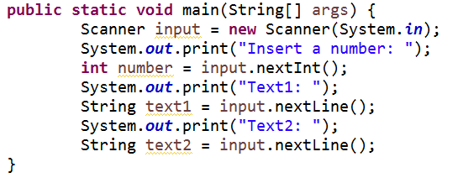

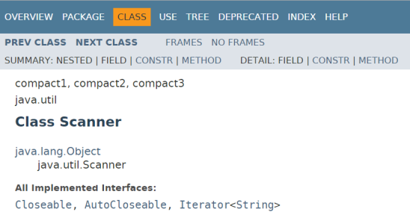


Scanner bug ..?
Notes:
http://stackoverflow.com/questions/7056749/scanner-issue-when-using-nextline-after-nextxxx
The problem is with the input.nextInt() command it only reads the int value. So when you continue reading with input.nextLine() you receive the "\n" Enter key. So to skip this you have to add the input.nextLine(). Hope this should be clear now.
Try it like that:
System.out.print("Insert a number: ");
int number = input.nextInt();
input.nextLine(); // This line you have to add (It consumes the \n character)
System.out.print("Text1: ");
String text1 = input.nextLine();
System.out.print("Text2: ");
String text2 = input.nextLine();
Or just use input.next()

Slide 8
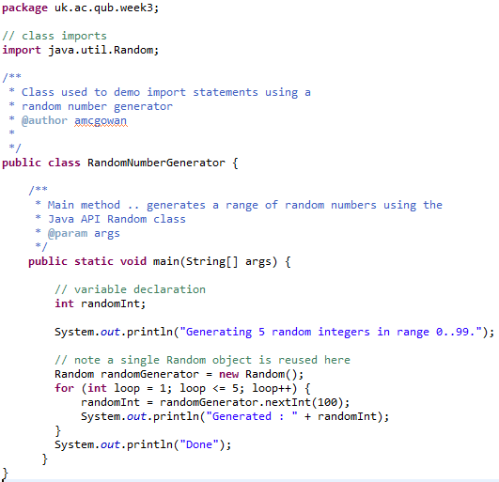
Random number generator
Import of Random class
Instantiation of Random class.
Use of Random class instance randonGenerator (object).

Slide 9
Other ways of using imports
The previous examples demonstrate an import followed the instantiation of the class imported.
It is however possible to use parts of some imported classes directly without creating the object instantiation.
These ready to use parts are declared internally within the imported class as static (more to come on this when we cover methods and OOP).

Slide 10
Static methods
Using static methods …
ClassName.methodName(arguments)
For example …
  Math.sqrt(1000);
Static method call to calculate the square root of 1000

Slide 11
Static fields
Using static fields…
ClassName.fieldName;
For example …
  Math.PI;
Static field reference

Slide 12

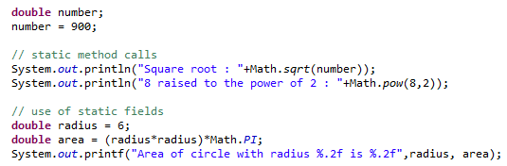

Use of static methods and static fields
The Math class is part of the java.lang package which is imported automatically into all Java programs so you do not need to an import statement in your class
Notes:
Note the Math class is part of the java.lang package which is imported automatically into all Java programs so you do not need to an import statement in your class

Slide 13
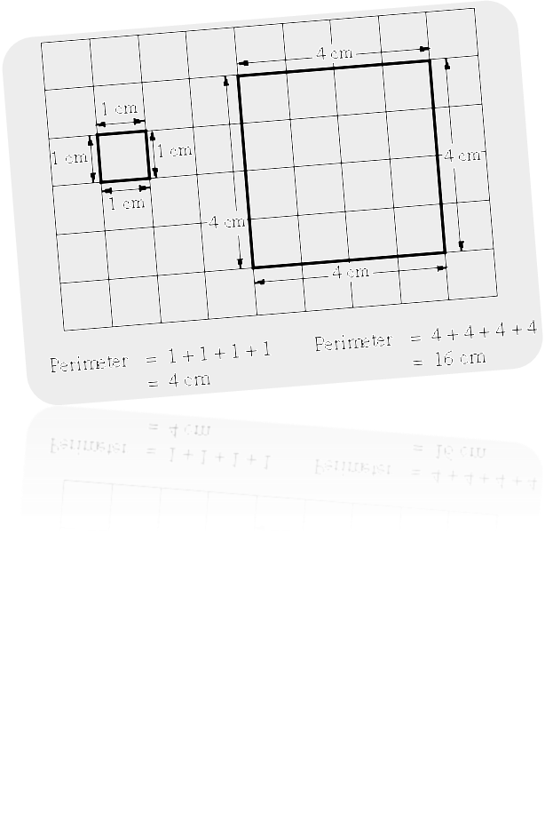
Exercise II
Create a Java program that prompts the user for the length of one side of a square (as a double). Then calculate and output the perimeter and the area of the square (to two decimal places)
Notes:
Scanner scanner = new Scanner(System.in);
double side = 0;
System.out.println("Enter the side of the square (in cms) ?");
side = scanner.nextDouble();
System.out.printf("Perimeter : %.2f %s",side*4 ," cm \n");
System.out.printf("Area : %.2f %s",Math.pow(side, 2) ," cm2");
scanner.close();

Slide 14
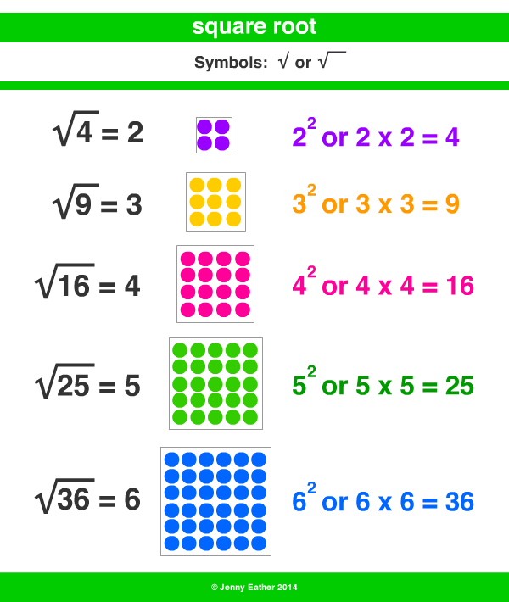
Exercise III
Create a Java program that prompts the user for a whole number and then outputs the square root of the number.
Notes:
package uk.ac.qub.week2;
import java.util.Scanner;
public class Exercise2 {
public static void main(String[] args) {
// declare var
int inputNum;
// initialise the scanner
Scanner scanner = new Scanner(System.in);
System.out.println("Enter number ...");
// read from keyboard
inputNum = scanner.nextInt();
// output the value - note the cast
System.out.println("Square root is : " + Math.sqrt(inputNum));
scanner.close();
}
}

